Slide 1

Chapter 2 Kali Linux: passwd, sudo, adduser, and addgroup
The following Chapter contains more examples and explanation on how to work with passwd, sudo, and user permissions. It is very important to be familiar with this chapter well.

Slide 2
passwd command:
passwd command is the command we use to change the password of the user.
We can also use the passwd command to view information about the user password such as expiration, user unlocked, locked, and also, we can change the settings.
We can use the sudo command before passwd if we want to change the settings of a specific user
In the following slides, we will be explaining all the basic commands of passwd.

Slide 3
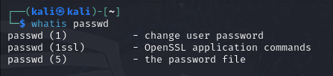
passwd command:
To get a quick definition of what passwd do, we can issue the following command line:
whatis command can tell you briefly what it does.

Slide 4


passwd Command:
If you want to view the help page of passwd, you can simply issue the command:
If you want to search for something specific, you can use slash followed by the word you are looking for: / activates search inside man command

Slide 5
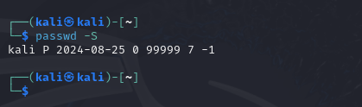
passwd Command:
passwd -S
The previous command displays the information related to the current user as it appears in the following image:
It displays respectively:
Username – pass word status – date – expiration date
0 in expiration date indicates that password will never expire.
In the following slide, we will learn more about changing the settings of a user password in kali Linux and it is pretty much the same procedure on all Linux Operating Systems.

Slide 6
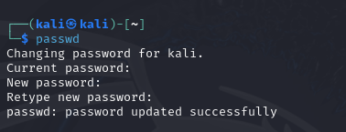
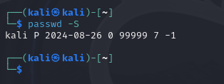
passwd Command:
passwd
Typing passwd alone prompts for changing the current user password. You will be asked to give the current password, and then, enter the new password, and finally, confirm it as you will see in the following image:
After changing the passwd, you will see the date is changed to today’s date. Indicating the password has been updated.

Slide 7
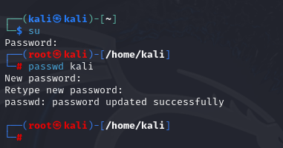
passwd Command:
passwd kali
To change the password of a user from the root user, we can issue the following command as it appears… the passwd <username>:
To change a user password, you must be the root user or another user with root privileges.

Slide 8
passwd Command:
Other options we can use with passwd:
passwd -l <username> ➔ lock user
passwd -u <username> ➔ unlock user
passwd -x <days> <username> ➔ set password expiration
passwd -e <username> ➔ forcing password immediate expiration
passwd -d <username> ➔ deleting password for a user
In the following slides, we will be viewing each output after issuing every one of the options above using passwd -S

Slide 9
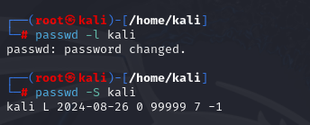

passwd Command:
passwd -l <username>
This the command to lock the username
passwd -u <username>
This command to unlock the username
To perform these commands, you must be the root user or a user with root privileges:

Slide 10
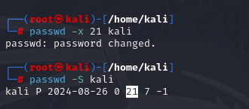
passwd Command:
passwd -x <days> <username>:
This is the command to specify an expiration date using days followed by the username, meaning, after that duration of time, the password will expire and the user will be prompted to renew the password:
As you can see, the 21 days is highlighted in the second command proving that the password will expire in 21 days.

Slide 11
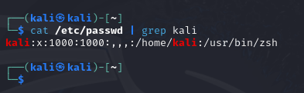
passwd Command:
To view the current users inside Kali Linux, we can issue the following command. The output will be omitted because it will displays a lot of users:
Note: using | grep command to display online kali user:

Slide 12
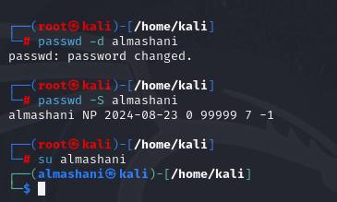
passwd Command:
passwd –d <username>:
This is the option we use to delete password for a user. For this one, we will be using a different username, Almashani, and we will use this option on:

Slide 13
Sudo Group
Some examples about sudo and what it is used for… we will be talking briefly about sudo group and how to use it on the basic level since it is the most important group on Linux Generally, and since we are using Kali Linux, it is the most important group to know about…

Slide 14

Sudo Group
Using whatis command to get a brief definition of sudo group:
What it means is that any new user added to this group will be able to execute all the commands and lines as the root user. In different words, the user will be able to update, upgrade, install, remove, …etc.
In the following slide, we will be showing the users who are considered sudoers, which means users who are members of the sudo group.

Slide 15
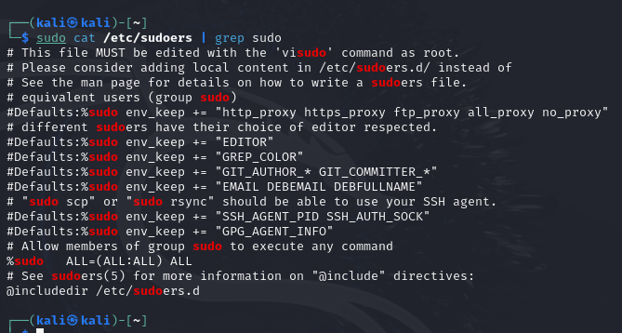
Sudo Group

Slide 16

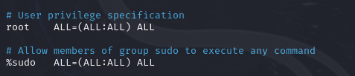
Sudo Group
To view the /etc/sudoers file, it is recommended to open it through visudo app because in case of an error, it will give you an alert before proceeding.
You will notice that root user and sudo group have the same privileges, which means a user that is a member of sudo group can have privileges, just need to type sudo before the command and provide its password
Notes:
Sudo Group in etc/sudoers:
Sudo is a group that is already a built-in group in Linux where its members has a privilege of executing everything similar to root user.
If we want to create a new group, we can add it to etc/sudoers and must make sure to assign the privileges to it.
Sudo group is again a built-in group that should not be assigned to all users. It is designated and controlled by the root user and should be granted to whoever the root see fits.
etc/sudoers should not be edited by any editor at all, it should be only edited by visudo because it will notify if there is a mistake and prevents proceeding without fixing it.
Any error in sudo group can cause a system crash and eventually, leading to the Linux System crashing. So it should always be dealt with caution.

Slide 17
Users in Linux
This section will be talking about creating a new user and defining a password for it. It will also explain how it can be added to the sudo group and then, we will revoke its rights from sudo group.

Slide 18
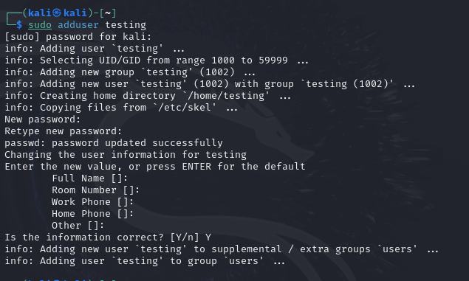
Adduser in Linux
To add a new user in Linux, you must be the root user or a user with sudo privileges. In this case, we will be using Kali User to add a new user with sudo:
adduser testing
Notes:
After issuing the command, you will be prompted to insert the kali user password. After that, you will be asked to enter a new password for user Testing. Then, you will be prompted to confirm the password. Finally, you will be given optional fields to fill out if you want such as full name, room number, work phone, home phone, and other.
Finally, you can choose Yes or Y, and your new user testing will be created.

Slide 19
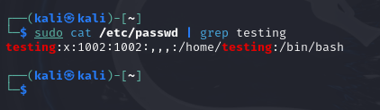
Viewing Users in Linux
To confirm if the user has been added or not, we can issue the following command line:
sudo cat /etc/passwd | grep testing
We are using | grep to search for only testing since the complete output will be big.

Slide 20
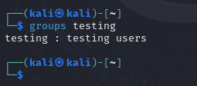
Viewing user groups in Linux
To view the groups the user testing is already member of:
Note:
We are viewing the groups of testing user from kali user. If you want to view the groups of a user while connecting to it, you can simply type: groups and the same result will appear.

Slide 21

Connecting to a user in Linux
To connect to testing:
su – testing
As you can see, when we issues the groups command inside testing and executed, we got the same groups like the previous slide.

Slide 22
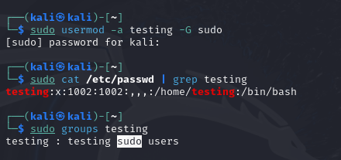
Adding user to a group Sudo
To add a user into a group sudo, we can use the usermod command:
usermod -a testing -G sudo ➔ -a stands for append -G stands for group

Slide 23
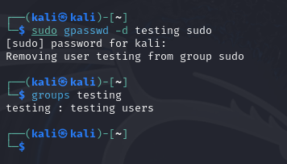
Removing user from Group Sudo
To delete a user from a specific group, we can issue the following command:
sudo gpasswd –d testing sudo
As you can see from the picture above, the user testing has been successfully removed from the sudo group.

Slide 24
Groups in Linux
This section talks briefly about groups in terms of viewing, creating, and deleting.

Slide 25
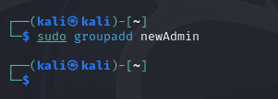
Creating a new Group in Linux
To create a new group, we can simply issue the following command:
Note, when creating a new user, a new group with the same user name is automatically created. But this part, we will be creating just a group.

Slide 26
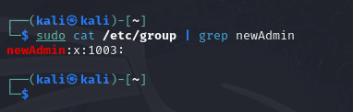
Viewing the newAdmin group added
To view, we can issue the following command using | grep to limit search to newAdmin group:

Slide 27
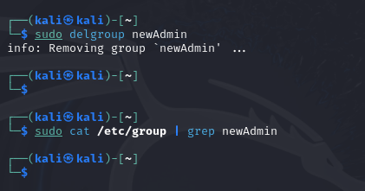
Removing a group newAdmin
To delete or remove newAdmin group, we can issue the following command line followed by confirming the deletion by viewing the /etc/group file using | grep search command:

